Slide 1

Must-have-caffeine
2021

Slide 2
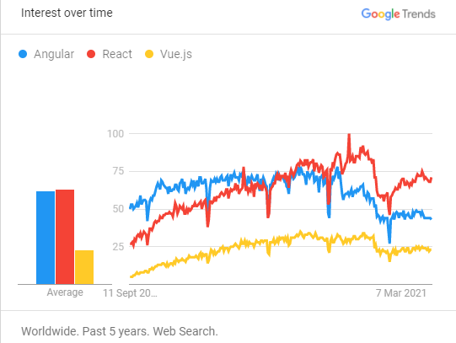
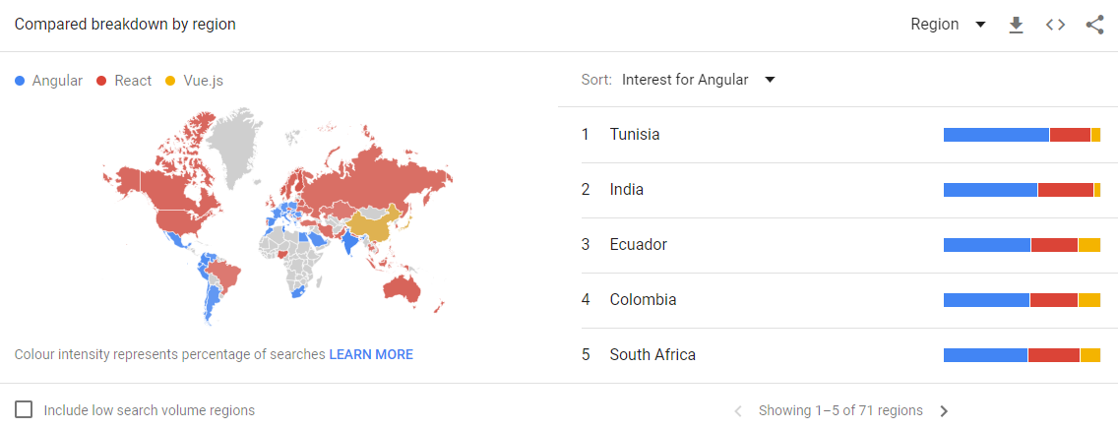
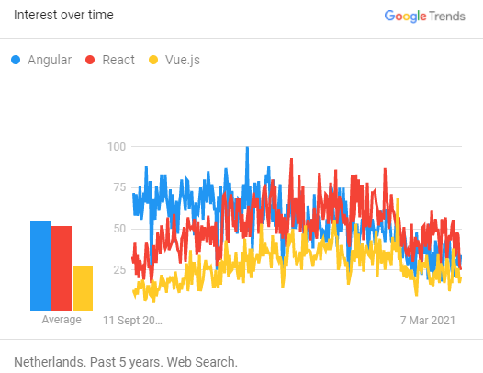
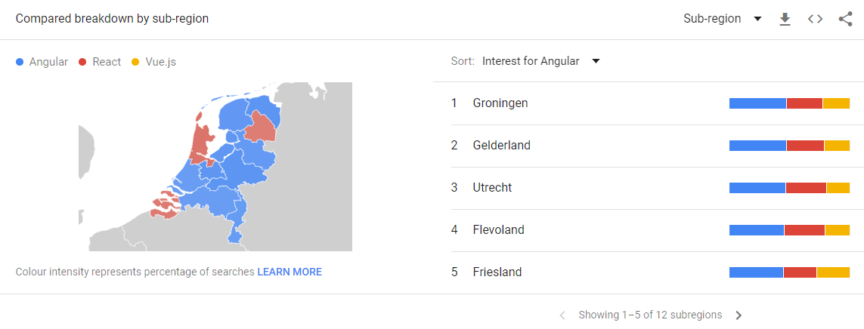
Google trends

Slide 3


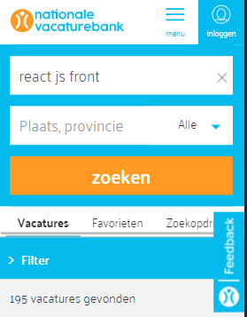
Nationale vacaturebank

Slide 4
React
React
Advantages:
Particularly effective with changeable data
Fast learning curve (with some HTML knowledge)
Flexible and Responsive
Interesting feature is that child data flow does not effect parent data
Light framework
Open source and huge community (many updates)
Cons:
Due to open source there is no structured manual. There is also little structure in the contributions that are made to this.

Slide 5
VueJS
Pros
One file components have simple syntax to follow.
Less boilerplate when creating new project.
Cons
Documentation is not always complete:
Issue with incorrect plugin dependency versions not documented.
Two-way field binding is supported; but in combination with a vuex store is not supported out-of-box, you need to define custom event handling.
Large functionality is more difficult maintain in one file.
Not all vue plugins are typescript compatible, when working with typescript.
More time needed to search for example solutions to implement functionalities not clear in boilerplate and standard documentation.
Notes:
RIchard

Slide 6
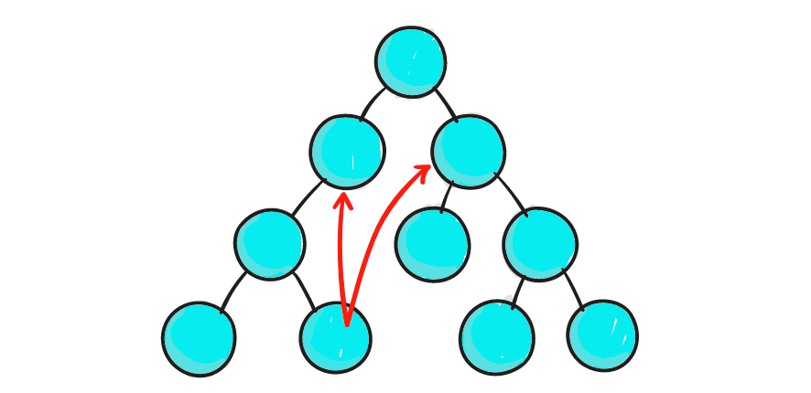
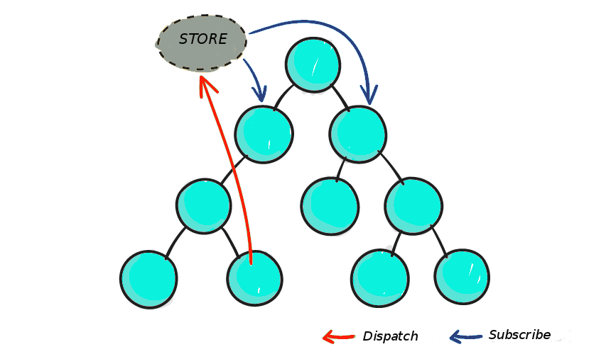
State management
Redux / Vuex
State management in a store
Based on functional programming
Notes:
A store is an application wide singleton service. … The problem with global application state is not the way that its created, its the fact that it exists.
Alternatively, in Angular we can inject services deep in the component tree if we want to
We can create shared data services that might or might not store the data [non-globally!]
https://blog.angular-university.io/angular-2-redux-ngrx-rxjs/
https://blog.logrocket.com/when-and-when-not-to-use-redux-41807f29a7fb/
https://www.merixstudio.com/blog/vuex-vs-redux/
https://www.stackchief.com/blog/Why%20you%20should%20NEVER%20use%20Redux%20with%20Angular

Slide 7
Angular
Framework around dependency injection (DI) (compare React which is simply a UI component library.)
Includes support for a lot of things --> third-party extensions not needed (although they are available)
Maintained by Google
Highly opinionated: more systemic and consistent
More initial boilerplate, less proliferation of boilerplate over time
Dependency injection is familiar
Easily store shared data via injected services (non-globally!) example
Familiar approach to Java and C# with static typing (TypeScript) and dependency injection
Clear separation of HTML, CSS and TypeScript.
Helpful CLI (ng generate component/service/module/interface "name")
Notes:
2.1) controlling the UI, reacting to user input, validating user input in forms, routing, state management sending Ajax Http requests, providing offline support & PWA capabilities, testing, building your application, managing multiple applications and connecting them and much, much more!
2.2) For example, no Axios because of it's own httpClientModule, no Redux because of things like DI, services, and RxJS (Observables)
5) (e.g. by Redux, which works by dispatching defined "actions" that functions called "reducers" interpret to update a centralized "store". This makes your app get messy fast.)
---------------------------------------------
Not overly flexible (like Vue) which makes it easier for a team (especially an inexperienced one) to stay on the same page and follow the same approach
Because Angular out of the box includes support for a lot of things. It helps you (= the developer) with controlling the UI, reacting to user input, validating user input in forms, routing, state management sending Ajax Http requests, providing offline support & PWA capabilities, testing, building your application, managing multiple applications and connecting them and much, much more!
The Angular team is of course a huge team of highly experienced developers
https://academind.com/tutorials/angular-vs-react-vs-vue-my-thoughts
React is simply a UI component library. Angular is a highly opinionated framework around dependency injection (DI).
And just like Angular doesn't need Axios because of it's own httpClientModule, it doesn't need Redux because of things like DI, services, and RxJS.... (Components subscribe to RxJS Observables in Angular, just like components subscribe to stores in Redux)
It seems working in Angular is more systemic and constant, as opposed to frameworks that need third-party extensions: Redux works by dispatching defined "actions" that functions called "reducers" interpret to update a centralized "store". This tends to generate a lot of boilerplate code as your app grows and gets messy fast. While Angular has its fair share of boilerplate, you don't need an excuse to add even more.
Remember that Redux was an answer to React problems. And just like Angular doesn't need Axios, it doesn't need Redux...
https://www.stackchief.com/blog/Why%20you%20should%20NEVER%20use%20Redux%20with%20Angular
A store is an application wide singleton service. … The problem with global application state is not the way that its created, its the fact that it exists.
Alternatively, in Angular we can inject services deep in the component tree if we want to
We can create shared data services that might or might not store the data [non-globally!]
https://blog.angular-university.io/angular-2-redux-ngrx-rxjs/
Conclusion: Why Angular?
Same reason we use Dotnet: it's an extensive and thoroughly developed framework of tools (modules), all managed by a professional company. No need to worry about incompatibility, versioning problems or other integration difficulties. And it is more familiar as it uses statically typed language (TypeScript) and Dependency Injection.

Slide 8
Our pick: Angular
Why Angular?
Same reason we use Dotnet: it's an extensive and thoroughly developed framework of tools (modules), all managed by a professional company.
No need to worry about incompatibility, versioning problems or otherintegration difficulties. And it is more familiar as it uses statically typed language (TypeScript) and Dependency Injection.
Notes:
2.1) controlling the UI, reacting to user input, validating user input in forms, routing, state management sending Ajax Http requests, providing offline support & PWA capabilities, testing, building your application, managing multiple applications and connecting them and much, much more!
2.2) For example, no Axios because of it's own httpClientModule, no Redux because of things like DI, services, and RxJS (Observables)
5) (e.g. by Redux, which works by dispatching defined "actions" that functions called "reducers" interpret to update a centralized "store". This makes your app get messy fast.)
---------------------------------------------
Not overly flexible (like Vue) which makes it easier for a team (especially an inexperienced one) to stay on the same page and follow the same approach
Because Angular out of the box includes support for a lot of things. It helps you (= the developer) with controlling the UI, reacting to user input, validating user input in forms, routing, state management sending Ajax Http requests, providing offline support & PWA capabilities, testing, building your application, managing multiple applications and connecting them and much, much more!
The Angular team is of course a huge team of highly experienced developers
https://academind.com/tutorials/angular-vs-react-vs-vue-my-thoughts
React is simply a UI component library. Angular is a highly opinionated framework around dependency injection (DI).
And just like Angular doesn't need Axios because of it's own httpClientModule, it doesn't need Redux because of things like DI, services, and RxJS.... (Components subscribe to RxJS Observables in Angular, just like components subscribe to stores in Redux)
It seems working in Angular is more systemic and constant, as opposed to frameworks that need third-party extensions: Redux works by dispatching defined "actions" that functions called "reducers" interpret to update a centralized "store". This tends to generate a lot of boilerplate code as your app grows and gets messy fast. While Angular has its fair share of boilerplate, you don't need an excuse to add even more.
Remember that Redux was an answer to React problems. And just like Angular doesn't need Axios, it doesn't need Redux...
https://www.stackchief.com/blog/Why%20you%20should%20NEVER%20use%20Redux%20with%20Angular
A store is an application wide singleton service. … The problem with global application state is not the way that its created, its the fact that it exists.
Alternatively, in Angular we can inject services deep in the component tree if we want to
We can create shared data services that might or might not store the data [non-globally!]
https://blog.angular-university.io/angular-2-redux-ngrx-rxjs/
Conclusion: Why Angular?
Same reason we use Dotnet: it's an extensive and thoroughly developed framework of tools (modules), all managed by a professional company. No need to worry about incompatibility, versioning problems or other integration difficulties. And it is more familiar as it uses statically typed language (TypeScript) and Dependency Injection.

Slide 9
Student Information System
"[A system] used to manage student data. It integrates students, parents, teachers and the administration. Student information systems provide capabilities for registering students in courses; documenting grading, transcripts of academic achievement and co-curricular activities, and the results of student assessment scores; forming student schedules; tracking student attendance; generating reports and managing other student-related data needs in an educational institution."
"Information security is a concern, as universities house an array of sensitive personal information..."
https://en.wikipedia.org/wiki/Student_information_system

Slide 10
Student Information System
First steps:
- Input students and courses
- Registrations

